Slide 1
Machine Learning Lesson 1 Hands On
Using the dataset Diamonds

Slide 2
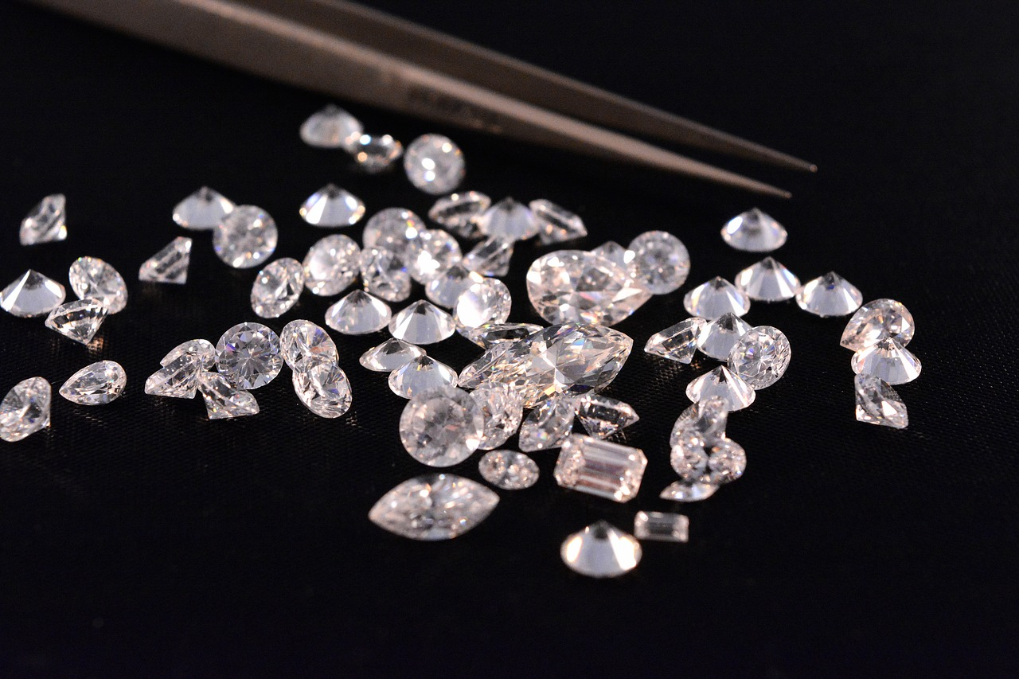
This problem asks…
This problem asked me to make a model to predict the price of a diamond given its
Carat
Cut
Clarity
Color

Slide 3
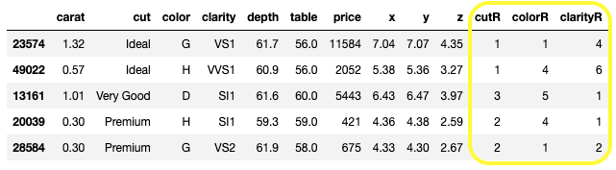
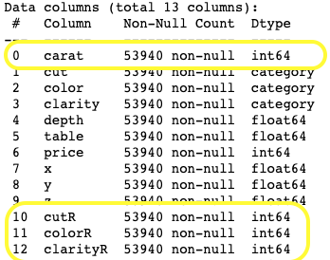
How I set up the data for analyzing
First, I had to look for what type of data each of the carat, cut, color and clarity were. I found that cut, color, and clarity were all categorical data, so I had to change them to a numerical equivalence using data wrangling skills, and then change those new versions of the data into integers. You can see the final result here:

Slide 4
Defined x and y variables
In order to run the analysis, I established which were the independent (x) variables and which variable was dependent. In other words, I had to state and set up that the carat, cut, color and clarity all could have an effect on the price of the diamonds.

Slide 5
Trained using some of the data to make a prediction model then test the model on rest.
Create a prediction using
60%
of the data:
32364 rows worth
Test the prediction on
40%
of the data:
21567 rows worth

Slide 6
Create the Model
I created a linear regression model fit to the training part of the data.
I used this code:
lm =LinearRegression()
lm.fit(x_train, y_train)
(not super exciting, but that is what happened)

Slide 7
Test the Prediction Model

Slide 8
Analyze the Predictions
First, I ran the prediction on the remaining 40% of the data and got values for the diamonds such as $7952, $1617, $7534, $7383, $1890, and $1799.
But, how accurate are those predictions?
Let’s graph it!

Slide 9
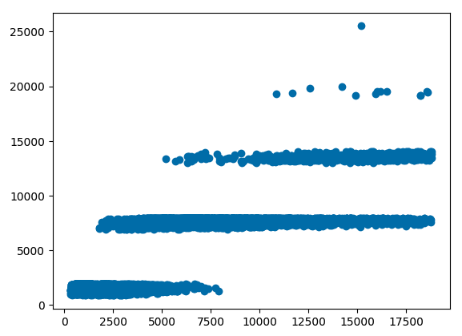
Plot of the Predictions: I find it’s interesting these are horizontally clumped, but don’t know what to do with it.

Slide 10
73.3%
Just how accurate is this prediction model?
of the time, our trained prediction model is accurate

Slide 11
Examining the error rates for the Model Fit
For this model, we split the data into a training group to make the prediction, and the test group to see how we did. Based on that, there is error. Here are the results from the different methods of looking at the data.
Mean Absolute Error: 1489.24
Mean Squared Error: 4217171
Root Mean Squared Error: 2053.6
All of which are way far away from the ideal, which is 0.

Slide 12
Double Check with a k-Fold Cross Validation
I then took the data and sliced it into 10 splits and “folded” it onto itself to test for the accuracy of the prediction model. All 10 tests resulted in similar accuracy to the original. 73.8% 71.4% 72.7% 73%
72.46% 72% 73.6%
73.7% 74.1% 73.8%
Therefore, I can say in all iterations of testing I did, I feel very confident that our model predicts 73% of the price of diamonds.

